Slide 1
注意事项:
请根据评估内容，提供一份文字的报告，可以用评估文件Word文档每条问题下面作答（回应必须以英语填写）
根据文字的报告，可以参考此幻灯片PPT的格式，建立一份PPT（请使用英语），在评估时向课程开发顾问做介绍
此PPT所有图片只是例子供贵院参考。如果贵院过去已使用PPT做介绍，可以继续使用旧的PPT更新内容。（问题2.1及3.1务必按此PPT格式填写）
由於评估时间有限，请使用大量的图片/录像展示中加班专业的教学活动
评估时可以准备相关的教课书、作业、考试卷等材料让课程开发顾问桧查
评估结束时，我院需要拷贝一份电子版的文字报告及PPT存档
请尽可能邀请更多的中加班授课老师参加评估会议，由於在讨论期间可能牵涉一些管理和教学问题，因此学生不必参加评估。
PPT 以英语介绍，省略翻译时间。

Slide 2
Holland College Annual Program Review
By Guiyang Vocational and Technical College
March 2017

Slide 3
Name of the EJV Program
Areas of Review
Students
Teaching/Instructors
Curriculum
Facilities/Resources/Equipment Updates
Employment/OJT
Others

Slide 4
1. Students

Slide 5
1. Students
1.1 Number of Students in each program year
1.2 Number of anticipated students to begin prep year in 2017
Class | Number
*Class 2017 (Prep Year) | 20
Class 2016 (2nd Year) | 20
Class 2015 (3rd Year) | 79
* forecast
Notes:
刘艺填写

Slide 6
1.3 Changes and updates to student recruitment for the Program
We’re enhancing our recruitment effort by hiring a dedicated recruiting team from “Chongqing Direct Info Tech Ltd.”. According to their solid work this year a constant recruitment number of student could be expected .
Notes:
刘艺填写

Slide 7

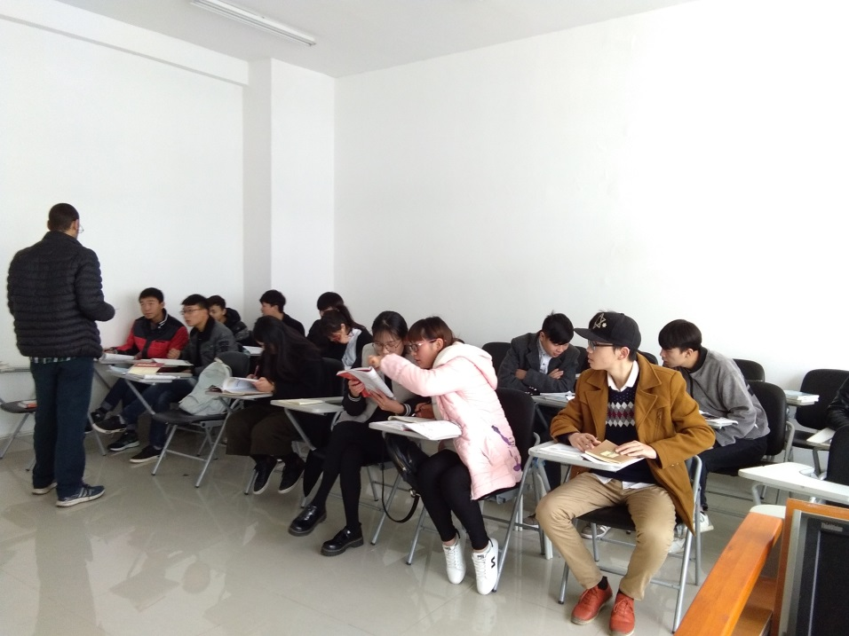

1.4 Methods or measures being used to assist students with their english proficiency, self-motivation and study skills.
Enhanced English skills training conducted by native speakers from UN volunteers
10hrs/week in first two semesters
Off-class talking opportunities provided to all students such as “English-corner”
Notes:
刘艺填写

Slide 8
1.5 Courses students find most challenging
CNET-1021 Cisco CCNA Routing and Switching Essentials
Most of the students had no experience in operating in a command line editing environment
Most of the students found it hard to understand abstract concepts in networking, especially in English
1.6 Courses students find most easiest
CMPS-1000 A+ Software
Most of the students were familiar with Windows operating system and using Windows utilities to manage their daily use of Windows
Most students found contents in this course relate closely to their daily use of computers, thus interested them most

Slide 9
1.7 what are attrition numbers for students
Reasons for attrition：
1. limited family incomes and educational budget
2. disadvantage in high school education
3. interest (some of the students are forced to school by their parents, and they show no interest in pursuing a diploma)
Notes:
刘艺收集学生退学数据

Slide 10
1.8 Results from students’ evaluation of program
Year | Month | Name | Course Title | Excellent | % | Good | % | Poor | %
2016 | 12 | 刘艺 | Routing & Switching Essentials：路由器和交换原理 | 5 | 100% | 0 | 0% | 0 | 0%
2016 | 12 | 刘艺 | Routing & Switching Lab: 交换机、路由器配置实训 | 5 | 100% | 0 | 0% | 0 | 0%
2016 | 12 | 郑江玥 | Windows Server Administrator：服务器管理 | 5 | 100% | 0 | 0% | 0 | 0%
2016 | 12 | 刘艺 | Computer Essentials：计算机网络基础 | 80 | 97% | 2 | 2% | 0 | 0%
2016 | 12 | Craig Nash | Windows Server Administrator：服务器管理 | 69 | 95% | 3 | 4% | 0 | 0%
2016 | 12 | Spencer MacPhee | Routing & Switching Essentials：路由器和交换原理 | 69 | 95% | 3 | 4% | 0 | 0%
2016 | 12 | 蒙晓暄 | Routing & Switching Lab:交换机、路由器配置实训 | 32 | 94% | 2 | 5% | 0 | 0%
2016 | 12 | 蒙晓暄 | CiscoCCNA I:Introduction to Networks:网络基础 | 32 | 94% | 2 | 5% | 0 | 0%
2016 | 12 | 刘颖 | Technical Conmmunications:技术交流 | 32 | 94% | 2 | 5% | 0 | 0%
2016 | 12 | ABEDEL | Practical English: 实用英语(中加) | 14 | 93% | 1 | 6% | 0 | 0%
2016 | 12 | 宋波 | Routing & Switching Lab: 交换机、路由器配置实训 | 34 | 89% | 4 | 10% | 0 | 0%
2016 | 12 | 蒙晓暄 | Windows Server Administrator：服务器管理 | 64 | 88% | 8 | 11% | 0 | 0%
2016 | 12 | 蒙晓暄 | A+ Hardware:硬件基础 | 64 | 88% | 8 | 11% | 0 | 0%
2016 | 12 | 蒙晓暄 | Routing & Switching Essentials：路由器和交换原理 | 63 | 87% | 9 | 12% | 0 | 0%
2016 | 12 | 宋波 | CiscoCCNA I:Introduction to Networks:网络基础 | 33 | 86% | 5 | 13% | 0 | 0%
2016 | 12 | 刘海波 | A+Software:软件基础 | 66 | 85% | 11 | 14% | 0 | 0%
2016 | 12 | 艾容 | Practical English: 实用英语(中加) | 12 | 80% | 3 | 20% | 0 | 0%
2016 | 12 | 王梅 | Technical Conmmunications:技术交流 | 29 | 76% | 9 | 23% | 0 | 0%
2016 | 12 | 刘正艳 | A+ Hardware:硬件基础 | 8 | 53% | 7 | 46% | 0 | 0%
Notes:
收集学生的评教数据

Slide 11
Teaching/
Instructors

Slide 12
2.1 New staff delivering EJV courses
Name of Instructor | EJV Course being taught | Educational Credentials | Number of Years of Teaching in the College/ University | Had been trained at Holland College （PEI) (If yes, please state which year?) | Had been participated in the EJV Best Practice Symposium held in China (If yes, please state which year?)
Song Bo | 1. CNET-1050 Network and Information Security 2. CNET-1010 CCNA-I | Master | 18 | NO | NO
Xie Hong | 1. CPRG-1000 Basics of Programming 2. CNET-2030 Web Technologies | Master | 19 | YES. 2015 Fall | NO
Liu Haibo | 1. CMPS-1000 A+ Software, 2. CNET-1100 Linux Administration | Master | 3 | YES. 2015 Fall | NO
Liu Yi | 1. CNET-1021 CCNA-II 2. CNET-2201 Network Analyze and Design | Master | 12 | NO | NO

Slide 13
2.1 New staff delivering EJV courses
Name of Instructor | EJV Course being taught | Educational Credentials | Number of Years of Teaching in the College/ University | Had been trained at Holland College （PEI) (If yes, please state which year?) | Had been participated in the EJV Best Practice Symposium held in China (If yes, please state which year?)
Wu Yan | COMM-1000 Techincal Communication | Bachelor | 12 | NO | NO
Tan Lijun | Object-Oriented Programming | Master | 20 | NO | NO
Zhong Zhengyong | CNET-2040 Voice and Video over Internet | Bachelor | 2 | NO | NO
Abedel(Eng) | English | Bachelor | 1 | NO | NO
Stephen(US) | English | Bachelor | 1 | NO | NO

Slide 14
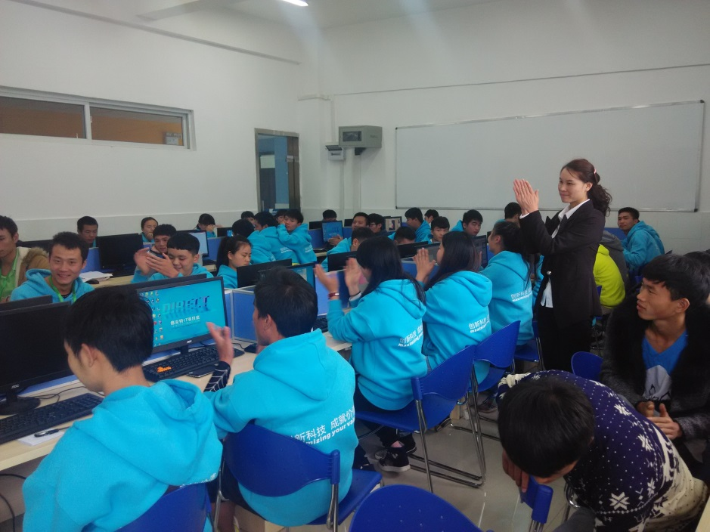
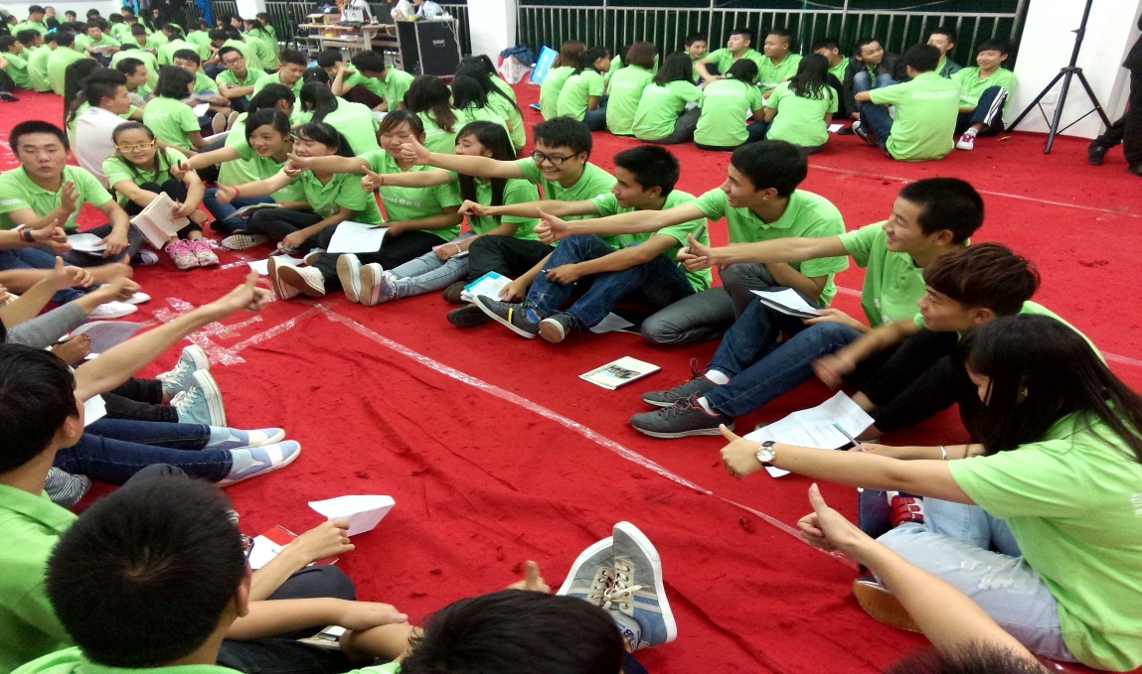
2.2 Teaching methods and strategies used in the program – elaborate on creative interactive students activities, projects.
Notes:
刘艺添加照片

Slide 15
2.3 What instructors find most challenging in delivering their course(s)
To make a difference in every aspect that the students feel they’re participating an EJV program rather than simply replacing course materials and schedules
2.4 What can we as (EJV partners) jointly work on for solutions to these challenges
Identify key elements that distinguish CBE from Chinese traditional educational methods and design a QA procedure to ensure we’re making progress in introducing CBE in our daily educational activities.

Slide 16
2.5 Professional development opportunities for EJV instructors
Instructors are assigned to companies and corporations for professional skills uplifting on a regular basis
Instructors are receiving trainings from government invited experts and researchers on a regular basis
2.6 Feedback on what instructors learned that changed them as an instructor(if instructors recently visited Holland College for training)
How to construct the relationship with students in a CBE preferred way

Slide 17
2.7 Feedback on what instructors benefited from at EJV Best Practice Symposium 2015 in Hainan.
NOT ATTENDED
2.8 What kind of training you would like to see at the upcoming EJV Best Practice Symposium 2017 in Guiyang.

Slide 18
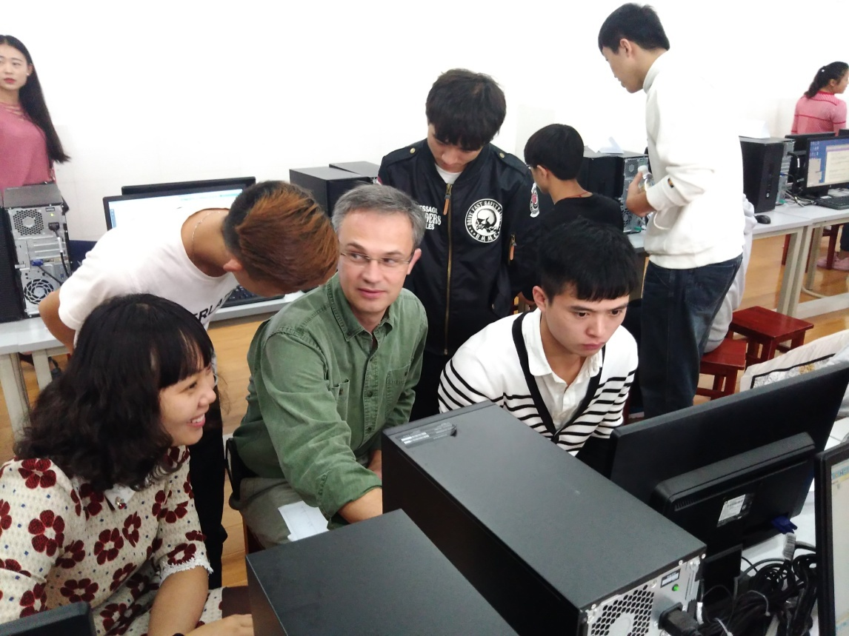
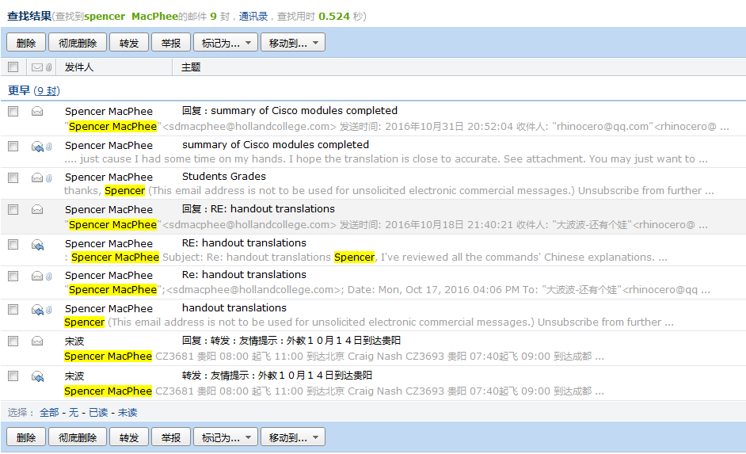
2.9 Discuss collaboration between EJV instructors
Spencer and Wu are co-teaching a lab
Spencer and Lewis use email to exchange course materials, including handout translation and students lab results

Slide 19
2.10 Opportunities for China faculty to visit Holland College

Slide 20
2.11 Discuss Holland College instructors who may have delivered EJV program courses at yours institution
*What was learned from this experience by both students and faculty?
Professionalism and integrity
Skills to get students involved
One on one evaluation of students’ performance
A practical and effective evaluation system
How to find highlight from every student and use it as a positive stimulation

Slide 21
3. Curriculum

Slide 22
3.1 Course schedule by semester
Name of Instructor | EJV Course being taught | Educational Credentials | Number of Years of Teaching in the College/ University | Had been trained at Holland College （PEI) (If yes, please state which year?) | Had been participated in the EJV Best Practice Symposium held in China (If yes, please state which year?)
Song Bo | 1. CNET-1050 Network and Information Security 2. CNET-1010 CCNA-I | Master | 18 | NO | NO
Xie Hong | 1. CPRG-1000 Basics of Programming 2. CNET-2030 Web Technologies | Master | 19 | YES. 2015 Fall | NO
Liu Haibo | 1. CMPS-1000 A+ Software 2. CNET-1100 Linux Administration | Master | 3 | YES. 2015 Fall | NO
Liu Yi | 1. CNET-1021 CCNA-II 2. CNET-2201 Network Analyze and Design | Master | 12 | NO | NO
Wu Yan | COMM-1000 Techincal Communication | Bachelor | 12 | NO | NO
Tan Lijun | Object-Oriented Programming | Master | 20 | NO | NO
Zhong Zhengyong | CNET-2040 Voice and Video over Internet | Bachelor | 2 | NO | NO
Abedel (Eng) | English | Bachelor | 1 | NO | NO
Stephen (US) | English | Bachelor | 1 | NO | NO
Notes:
请刘艺,谢红提供一下

Slide 23
3.2 Provide a sample of instructor’s lesson plan and
assessments from one of the program courses
Notes:
刘海波准备

Slide 24
3.3 Discuss and provide comments on the delivery of course curriculum over the last year
Professionalism
Teaching Skills
Students Participation
Evaluation
Notes:
去年的教学情况，共同商讨

Slide 25
4. Facilities/
Resources/
Equipment
Updates

Slide 26
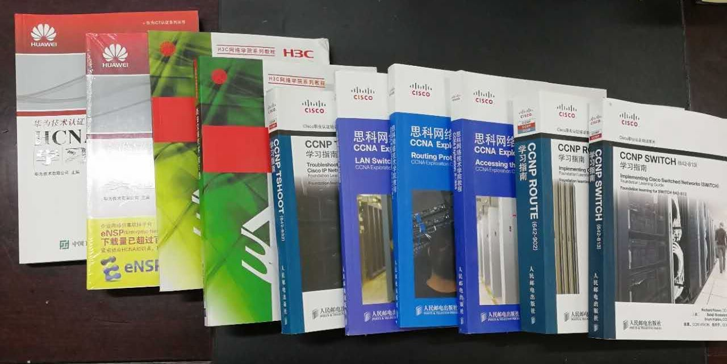
4. 1 Availability of books and resources

Slide 27
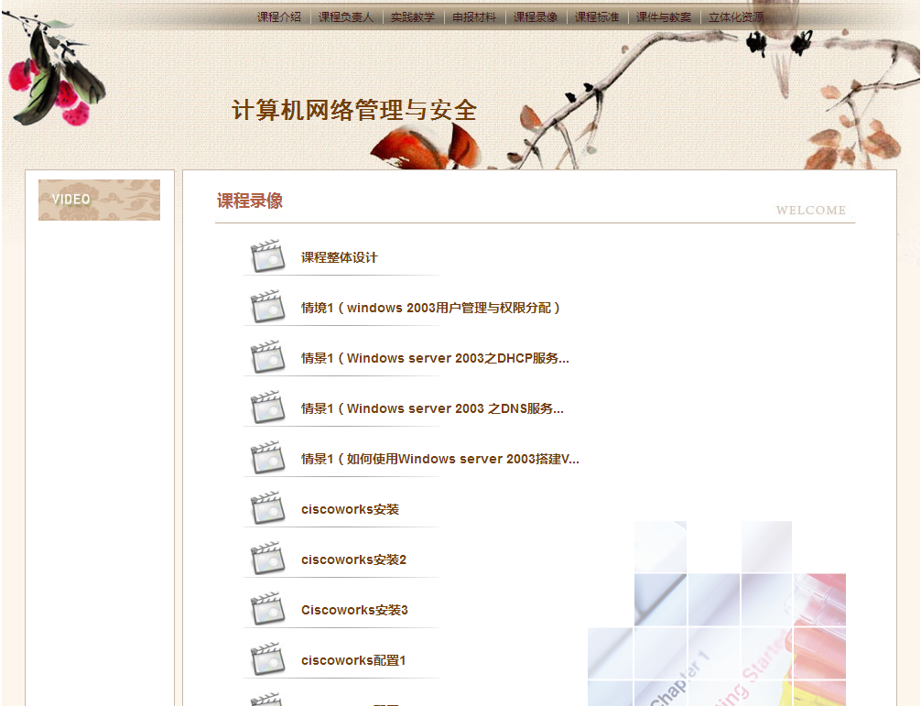
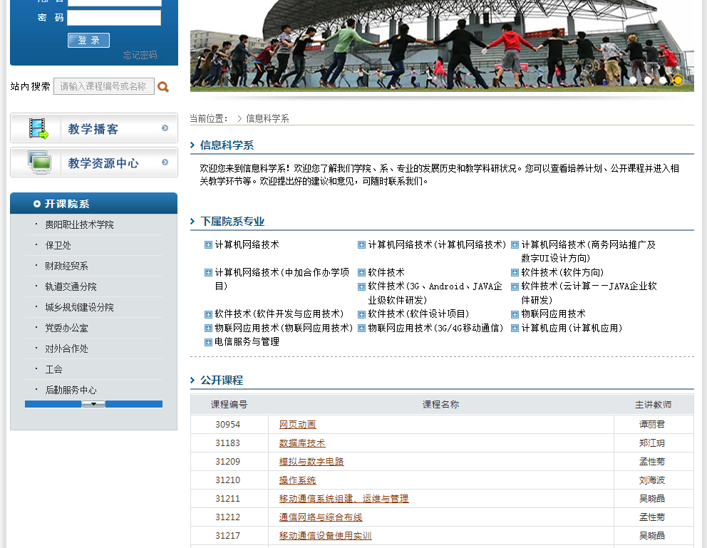
4. 1 Availability of books and resources

Slide 28
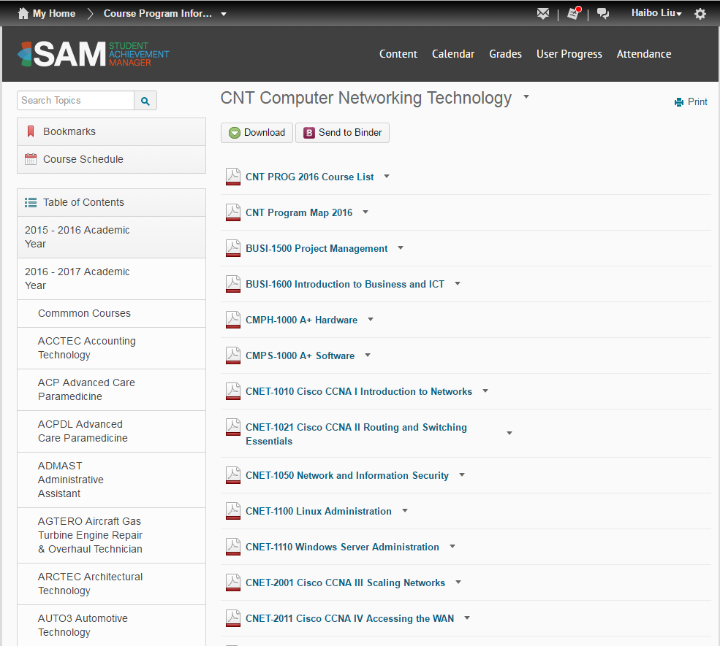
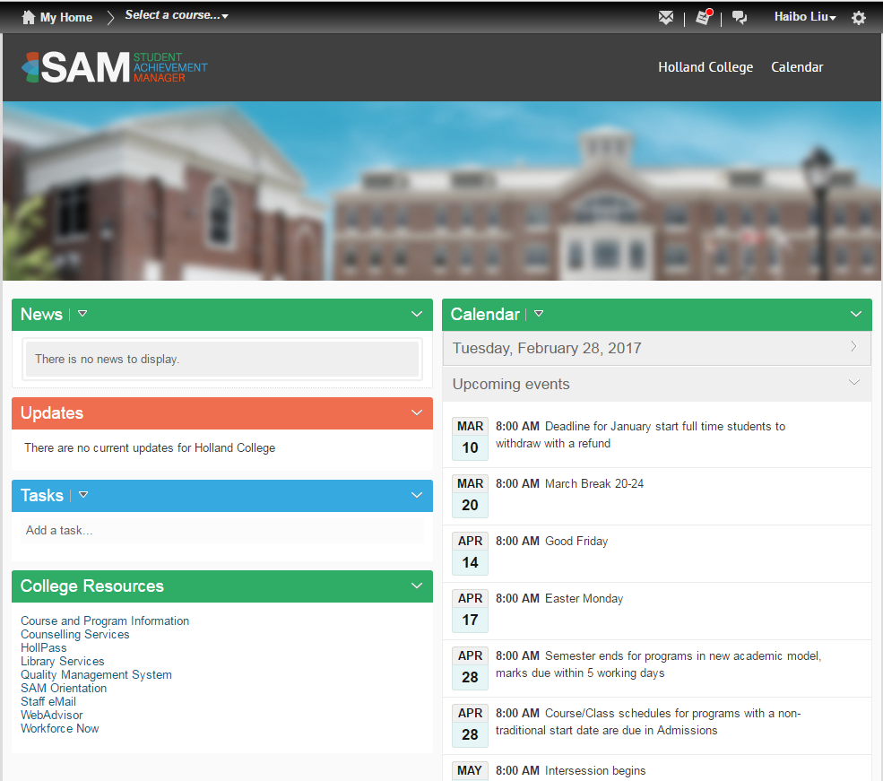
4. 2 Usage of SAM Resources

Slide 29
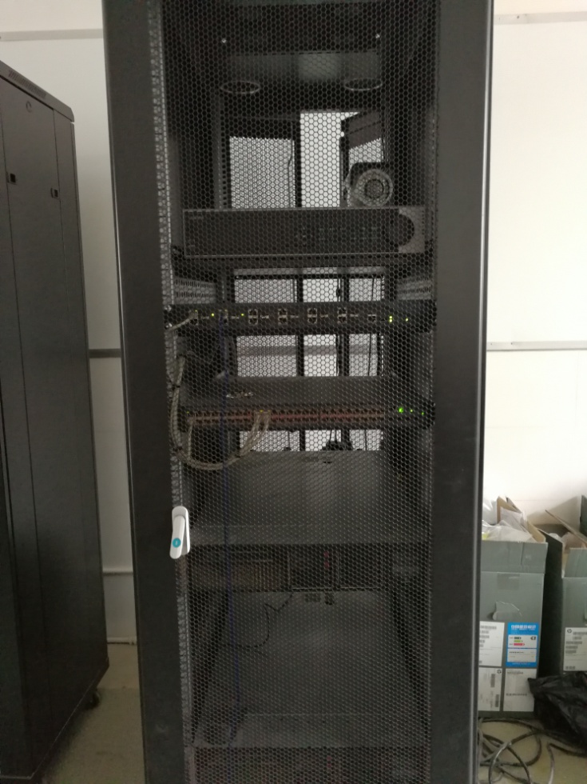
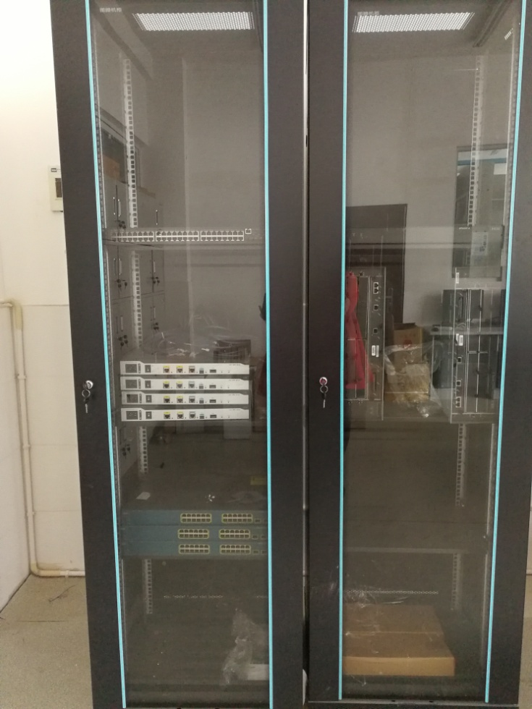
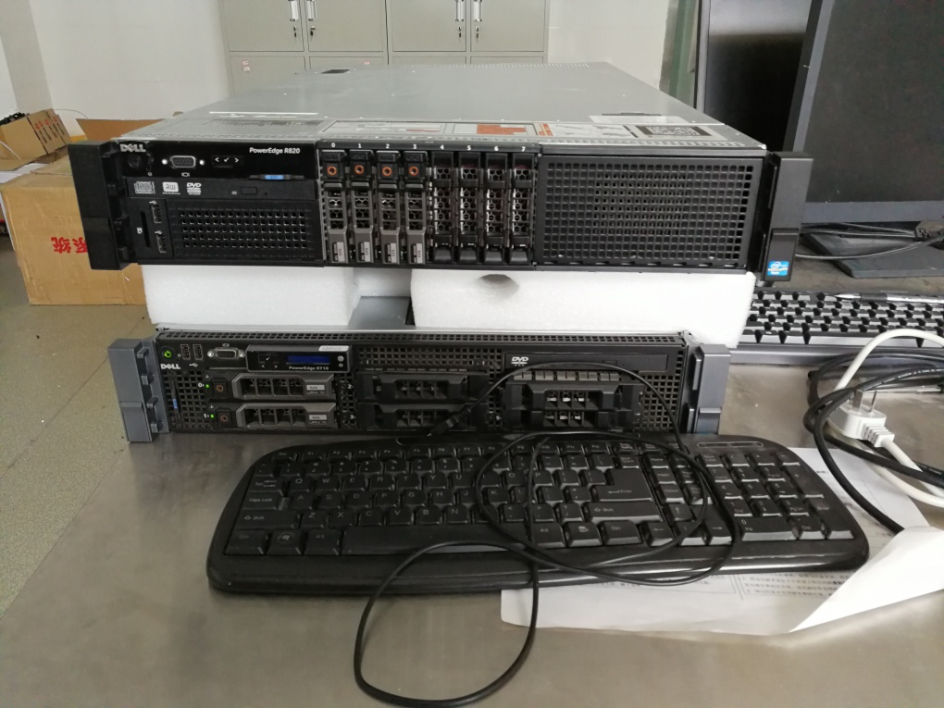
4. 3 Equipment and Facilities
Servers and switchers for Windows & Linux server administration courses
Notes:
刘艺准备图片

Slide 30
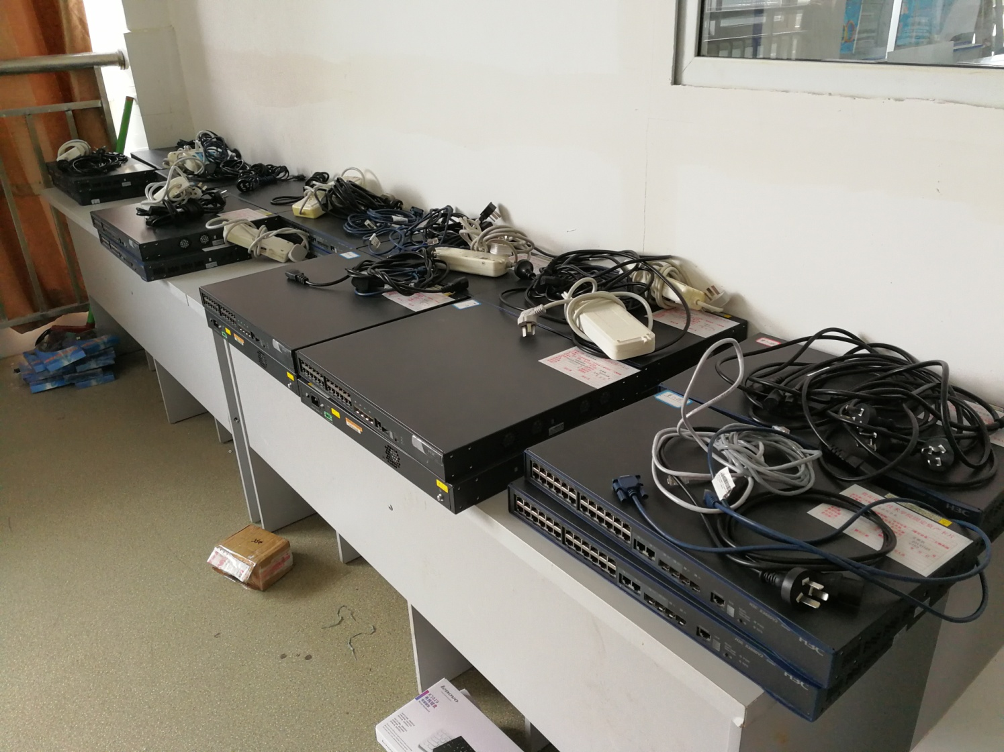
4. 3 Equipment and Facilities
Routers and switchers used in teaching Routing and Switching Essentials

Slide 31
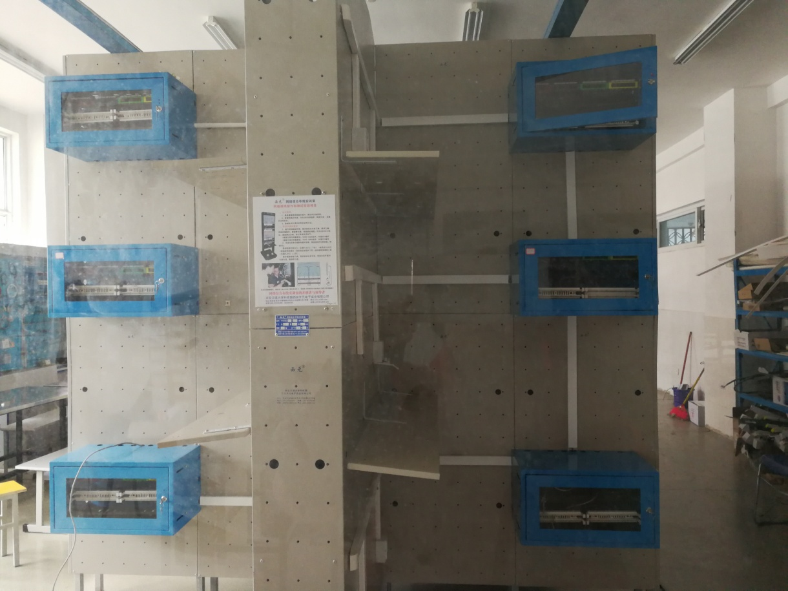
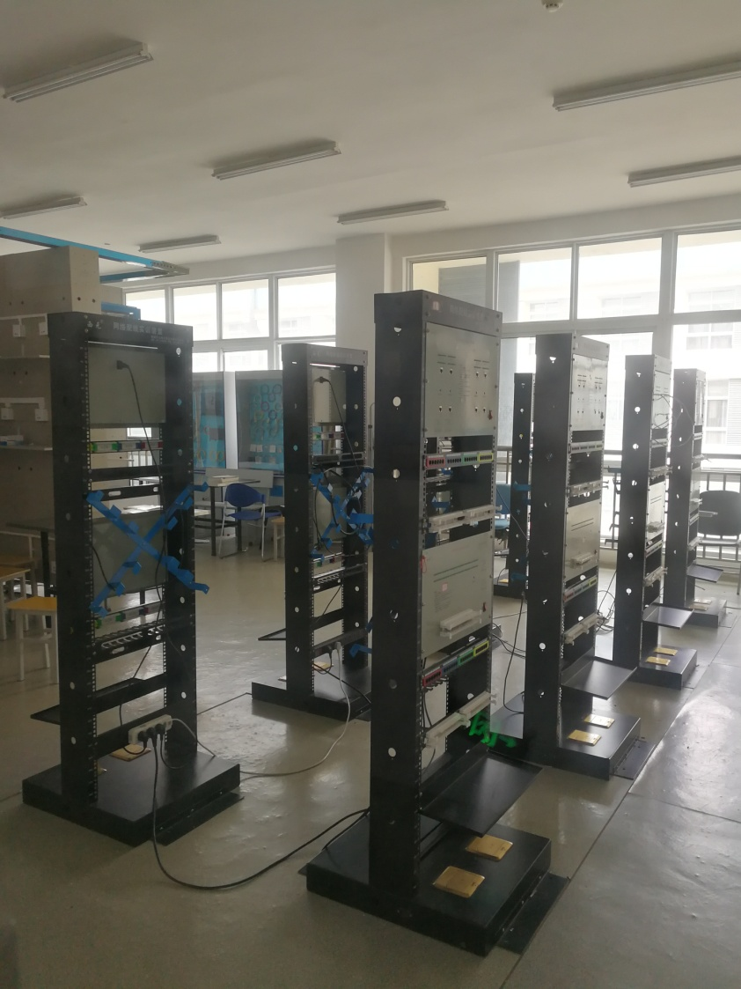
4. 3 Equipment and Facilities
Networking Training Room

Slide 32
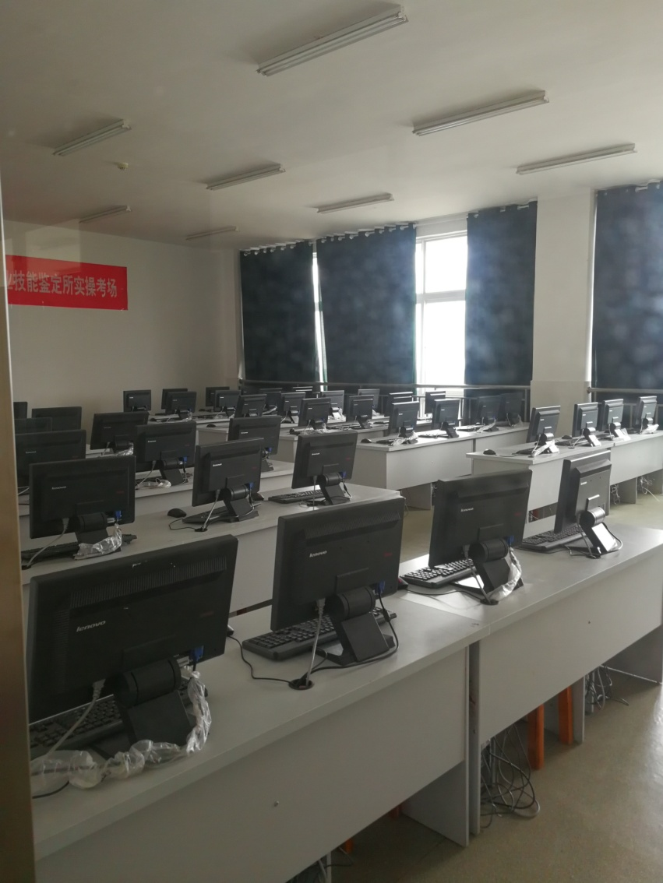
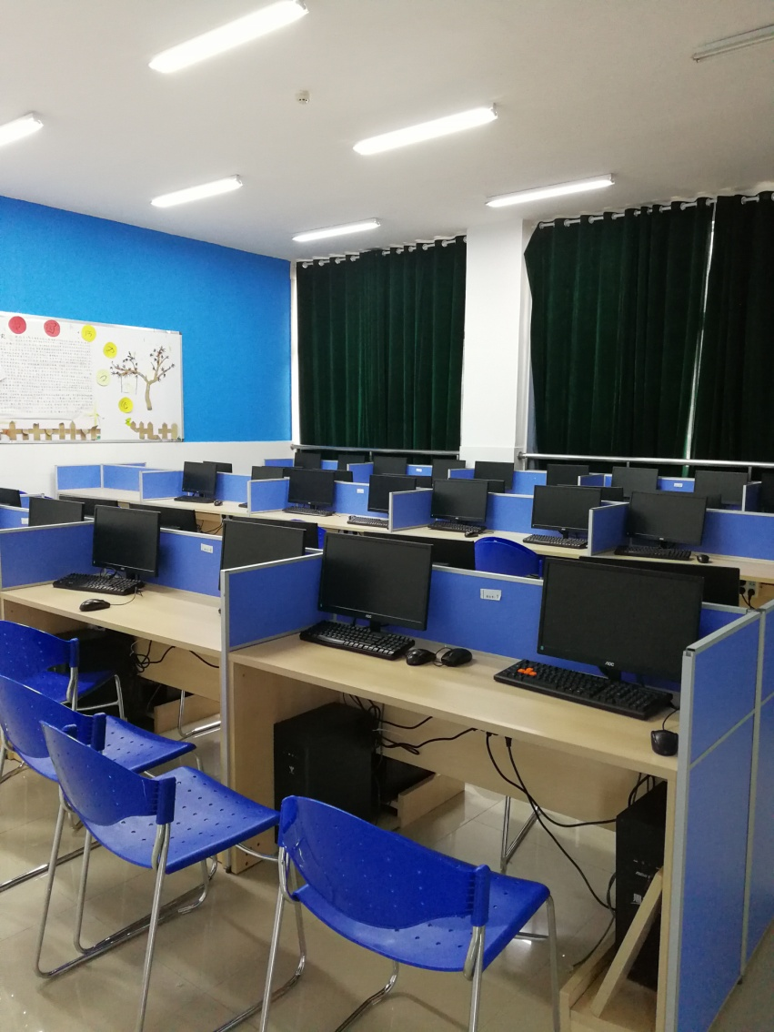
4. 3 Equipment and Facilities
Class Rooms with multimedia broadcasting devices

Slide 33
5. Employment
OJT

Slide 34
5. 1 Employment information of students
NO GRADUATE YET
Employment Status of 2016 graduating class
Employment Status | Number of Students
Employed | 18
Starting own business | 2
Further study | 3
Study Abroad | 1

Slide 35
5. 2 Any updates on status of industry and OJT partners?
Name of Company | Contact Person | Tel | Address
Jiaxin Educational Tech Ltd. | Pan Ritao | 13208028486 | Jinyang Technology Industry Campus B401, Guiyang High Tech Zone
Micro Study Educational Tech Ltd. (Microsoft partner) | Huang Jianguo | 13628569326 | Huangguoshu Plaza A13-3, Zhonghua North Rd. 126, Guiyang
Chongqing Direct Info Tech Ltd. | Zhou Jisong | 18523417007 | Micro-electronics Industry Campus, Shapingba District, Chongqing
Notes:
校企合作名录

Slide 36
6. Other

Slide 37
6.1 Strengths of our EJV
Mutual Beneficial
The very few EJV program approved by Department of Education of China in Guiyang vocational schools
Very experienced instructors and project management team
Notes:
刘海波准备

Slide 38
6.2 Challenges of our EJV
Language barrier
Professionalism and language skills of instructors
How to guarantee the quality procedure been executed with the absence of
a mechanical designed to ensure the procedure
key participants
culture and environment limitations
Notes:
刘海波准备

Slide 39
6.3 Additional comments
Notes:
刘海波准备

Slide 40
7. Recommendation
Updates

Slide 41
Improve accessing efficiency of SAM resource, especially QF related documents
Enhance CNT program and course developing training

Slide 42
Q&A

